Slide 1

TURTLE GAMES
Notes:
Great to see all of you
For those of you who don’t know mw, my name is
Of course, we have had preliminary discussions about your data and I would now like to share my findings with you.

Slide 2
How can Turtle Games leverage
their loyalty programme
to improve sales performance?
Notes:
You mentioned that your main focus is sales performance and the data is focussed around loyalty points, the main question is How can Turtle Games leverage their loyalty programme to improve sales performance?

Slide 3



Approach
Data Import
Data Preparation
Exploratory Analysis
Recommendations
Notes:
Python in Jupyter was used to analyse the realtionships between the variables, customers clusters and reviews and R was used especially for some visualisation options.
Data was imported, prepared and cleaned to anylse it for recommendations.

Slide 4
Loyalty Points
Audience
Reviews
Notes:
How are we going to answer the question – by looking at these 3 areas which are loyalty points, audience and reviews.

Slide 5
Loyalty Points
Notes:
Starting with loyatly points and locking the customer in

Slide 6
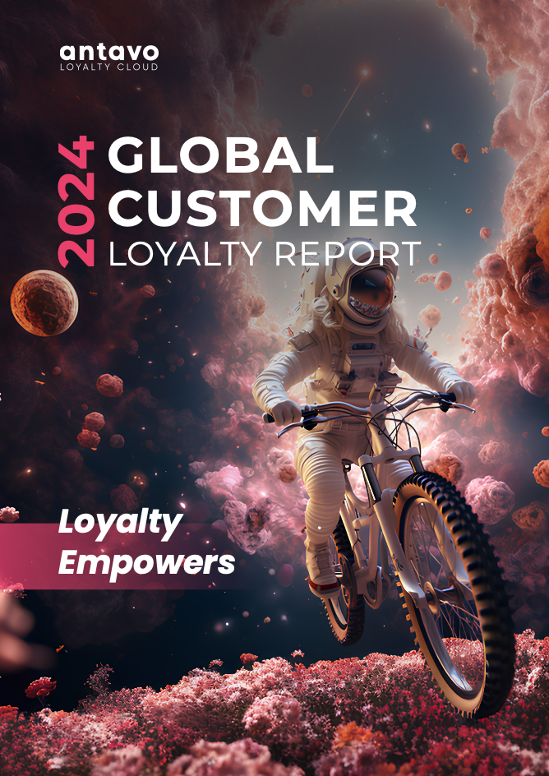
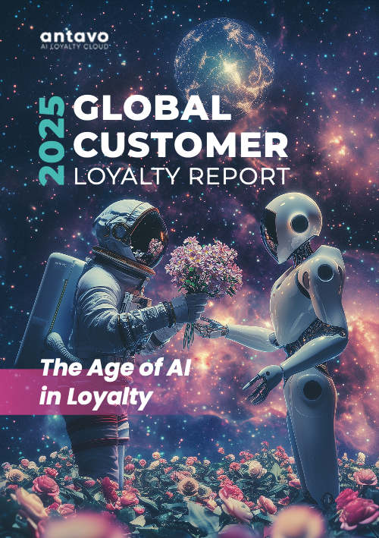
Purpose of loyalty programmes
“ Twice as many companies want to increase their investment in customer retention versus acquisition. ”
“ 83.0% of companies who measure the ROI reported positive results, with the reported ROI being 5.2X on average. ”
Notes:
Why are loyalty programmes important?
Here we have some quotes from the Global Customer Loyalty Report published by Antavo every year.
Antavo is a loyalty technology provider that builds comprehensive loyalty programs to foster brand love and change customer behaviour.
They find that keeping existing customers is more important than attracting new ones:
Also, respondents reported that their loyalty programmes generates 5.2 times more revenue than it costs.

Slide 7
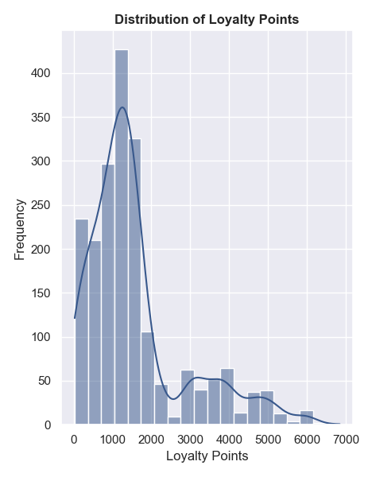
Loyalty Points
Variables
Remuneration
Spending Score
Age
Gender
Education
Product Codes
Goal
Notes:
Now looking at your loyalty point structure, you can see the distribution of loyalty points.
This will be used as a measure of sales performance as we do not have direct sales revenue data.
The data is right skewed with a mean of around 1500.
There are outliers with much higher loyalty points and of course the goal is to shift the mean to the right with higher average points.
So we will check how the other variables impact loyalty points, that is remuneration, spending score, age, gender, education and product codes.

Slide 8
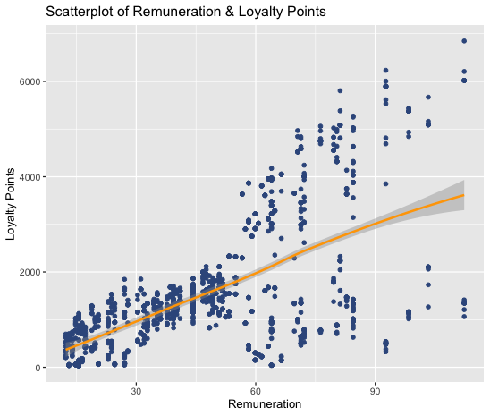
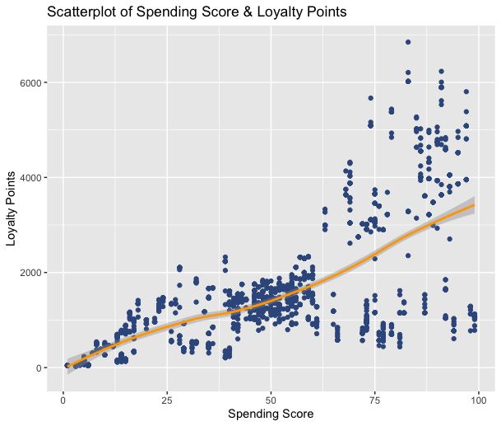
Impact on Loyalty Points
Notes:
Here you can see scatter plots of the remuenration vs loyalty points and spending score versus loyaltly points.
Both graphs show a positive relationships which is not quite linear and a larger variation as the variables increase.
A positive relationship is expected as highe income means more purchases can be made and the spending score and loyalty pointy must be linked already.

Slide 9
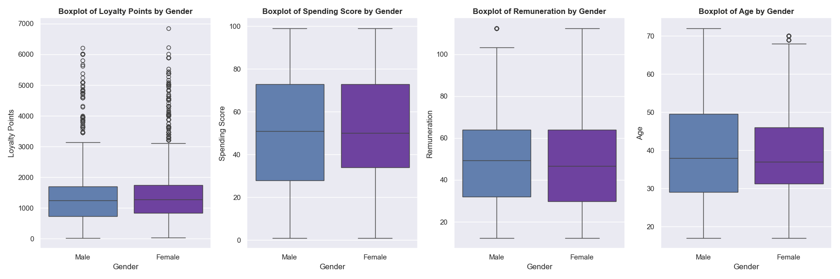
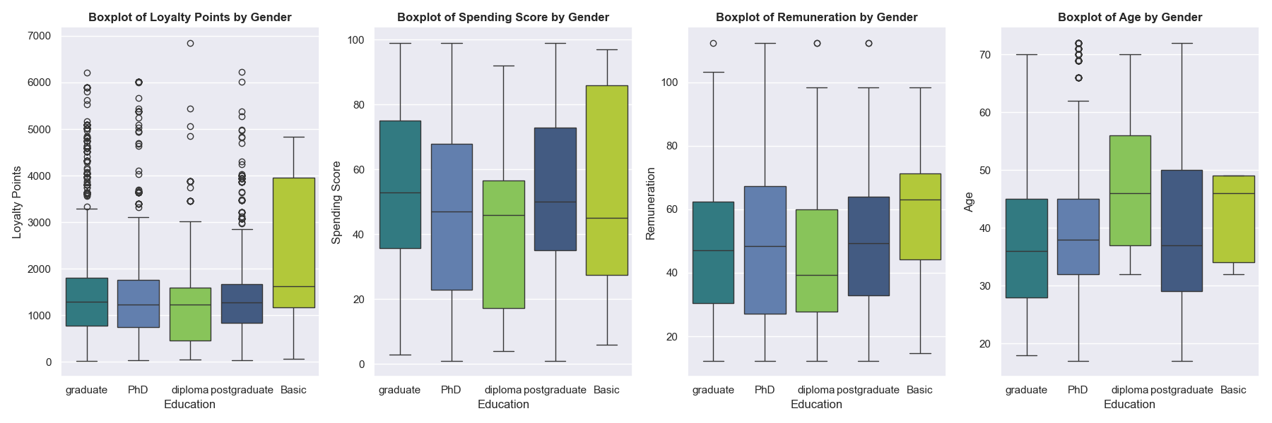
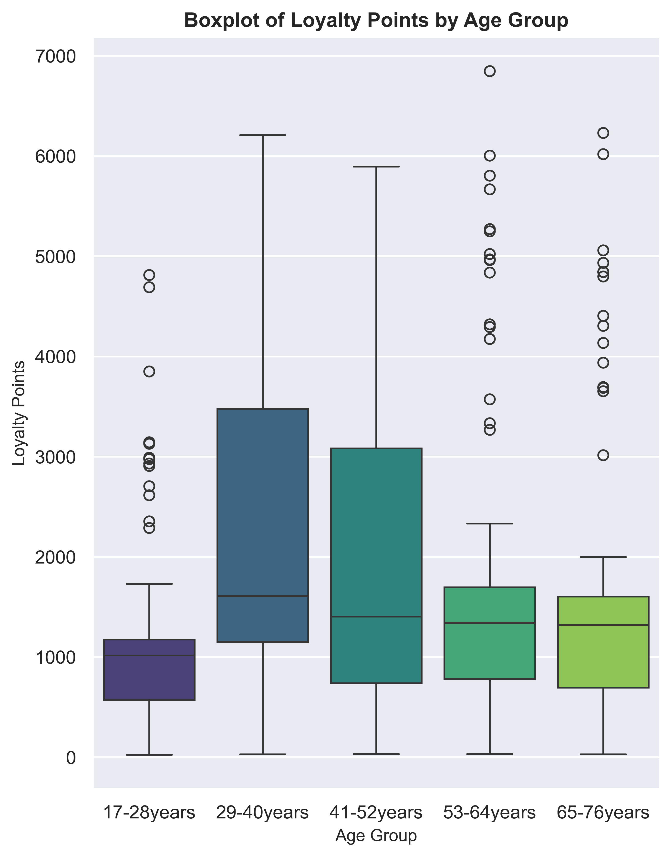
Impact on Loyalty Points
44% Males & 56% Females
>88% at least graduate
43%
Notes:
Gender almost balanced and the mean loyalty points are comparable.
Education is homogeanous with 88% having graduate level eduaction or above.
Age has some impact. With 43% of the dataset in the 29 to 40 year age group,
There are 200 product codes that cannot be linked to products or products groups, so not included here.

Slide 10
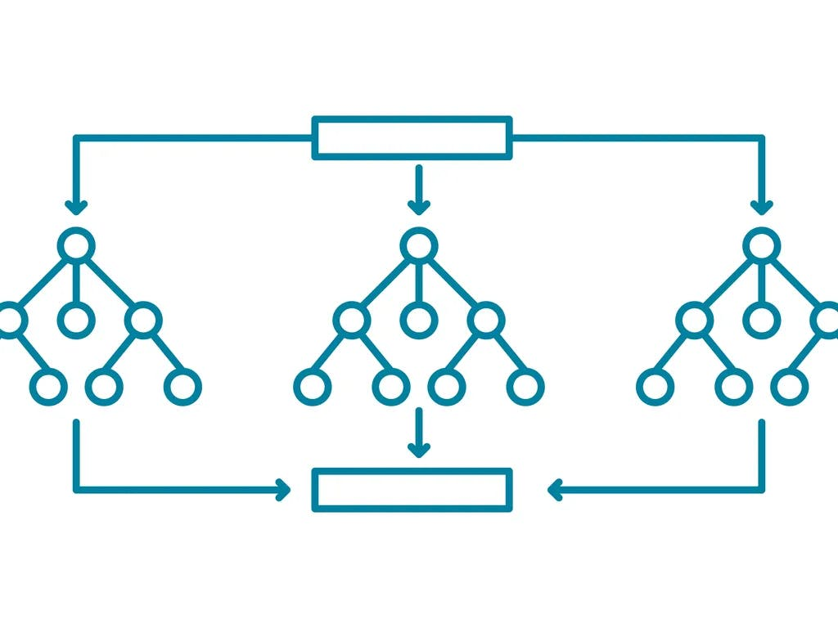
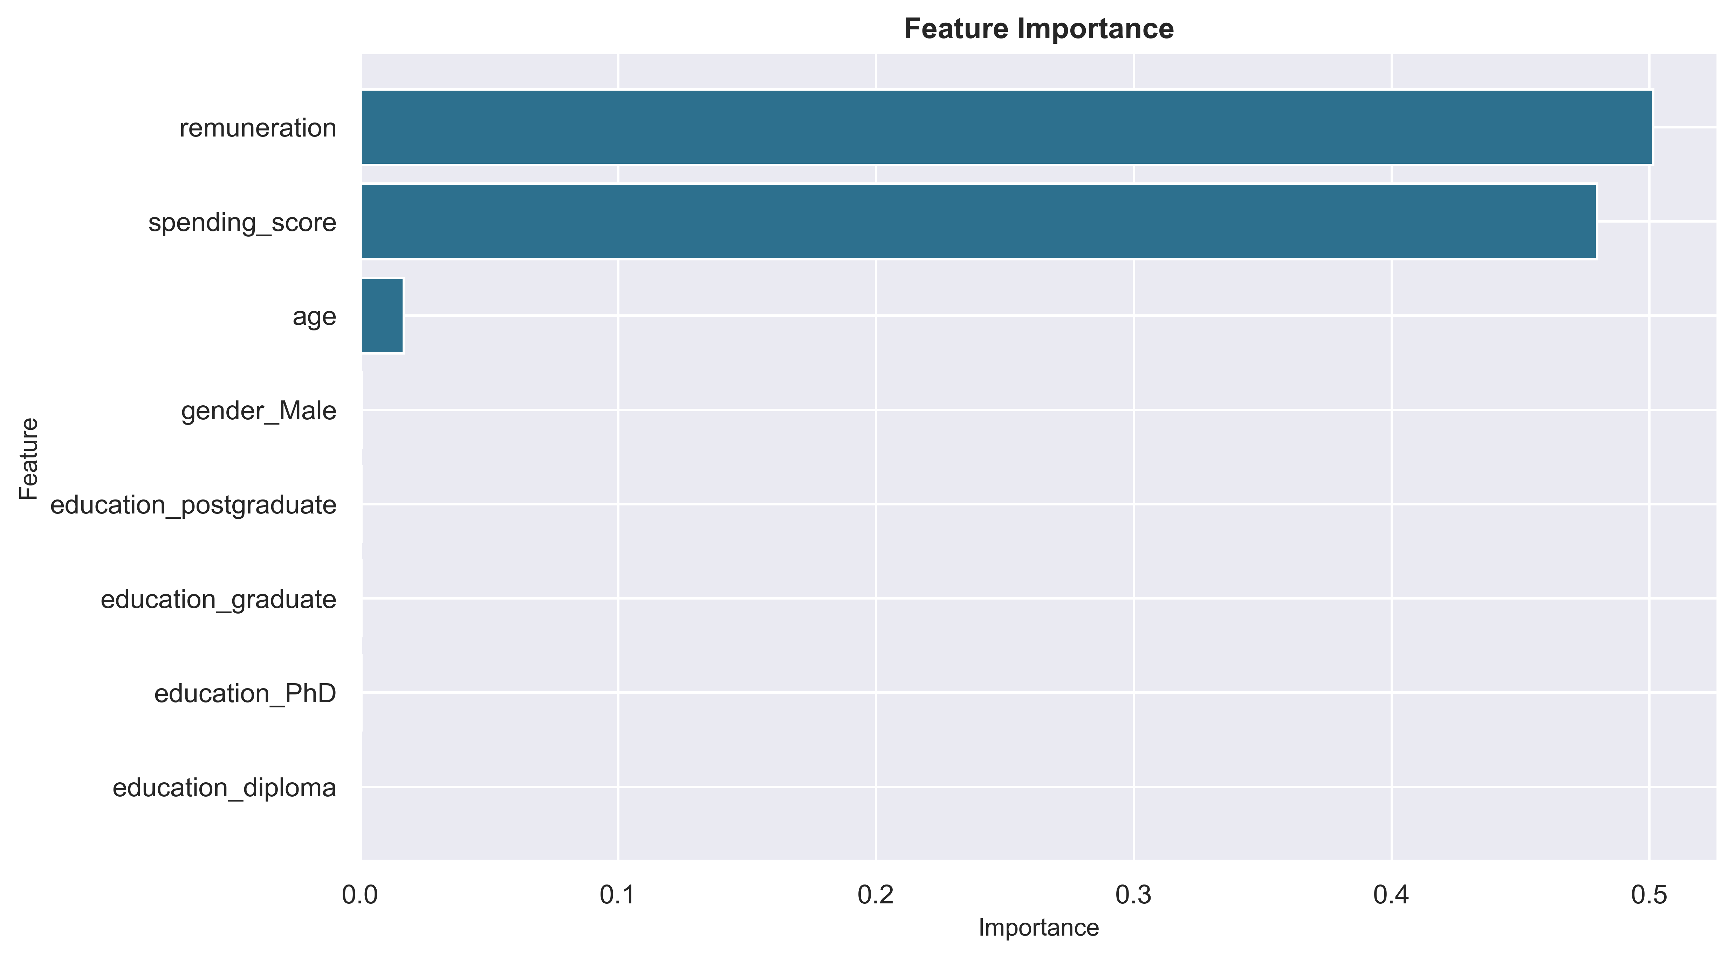
Model Results – Random Forest
Remuneration
Spending Score
Age
0.501
0.479
0.016
Notes:
After reviewing various model, a model called random forest gives the best fit, as it gives the most robust results for the wide range of loyalty points and makes the most accurate predictions.
A random forest starts with individual decision trees. They work on the basis of a question that divides your data into two groups based on certain criteria, so you can see the branches here.
A random forest consists of many trees. We can of course look at the model in more detail later if you are interested.
According to the model the main influences on loyalty pointy in the dataset are remuneration and spending score, with age having a small impact, as well.
So, an increase in income and spending, increases loyalty points and with that sales performance.

Slide 11

Audience
Notes:
Next we look at your audience and customer base. And whether there any characteristics that allow us to group them.

Slide 12
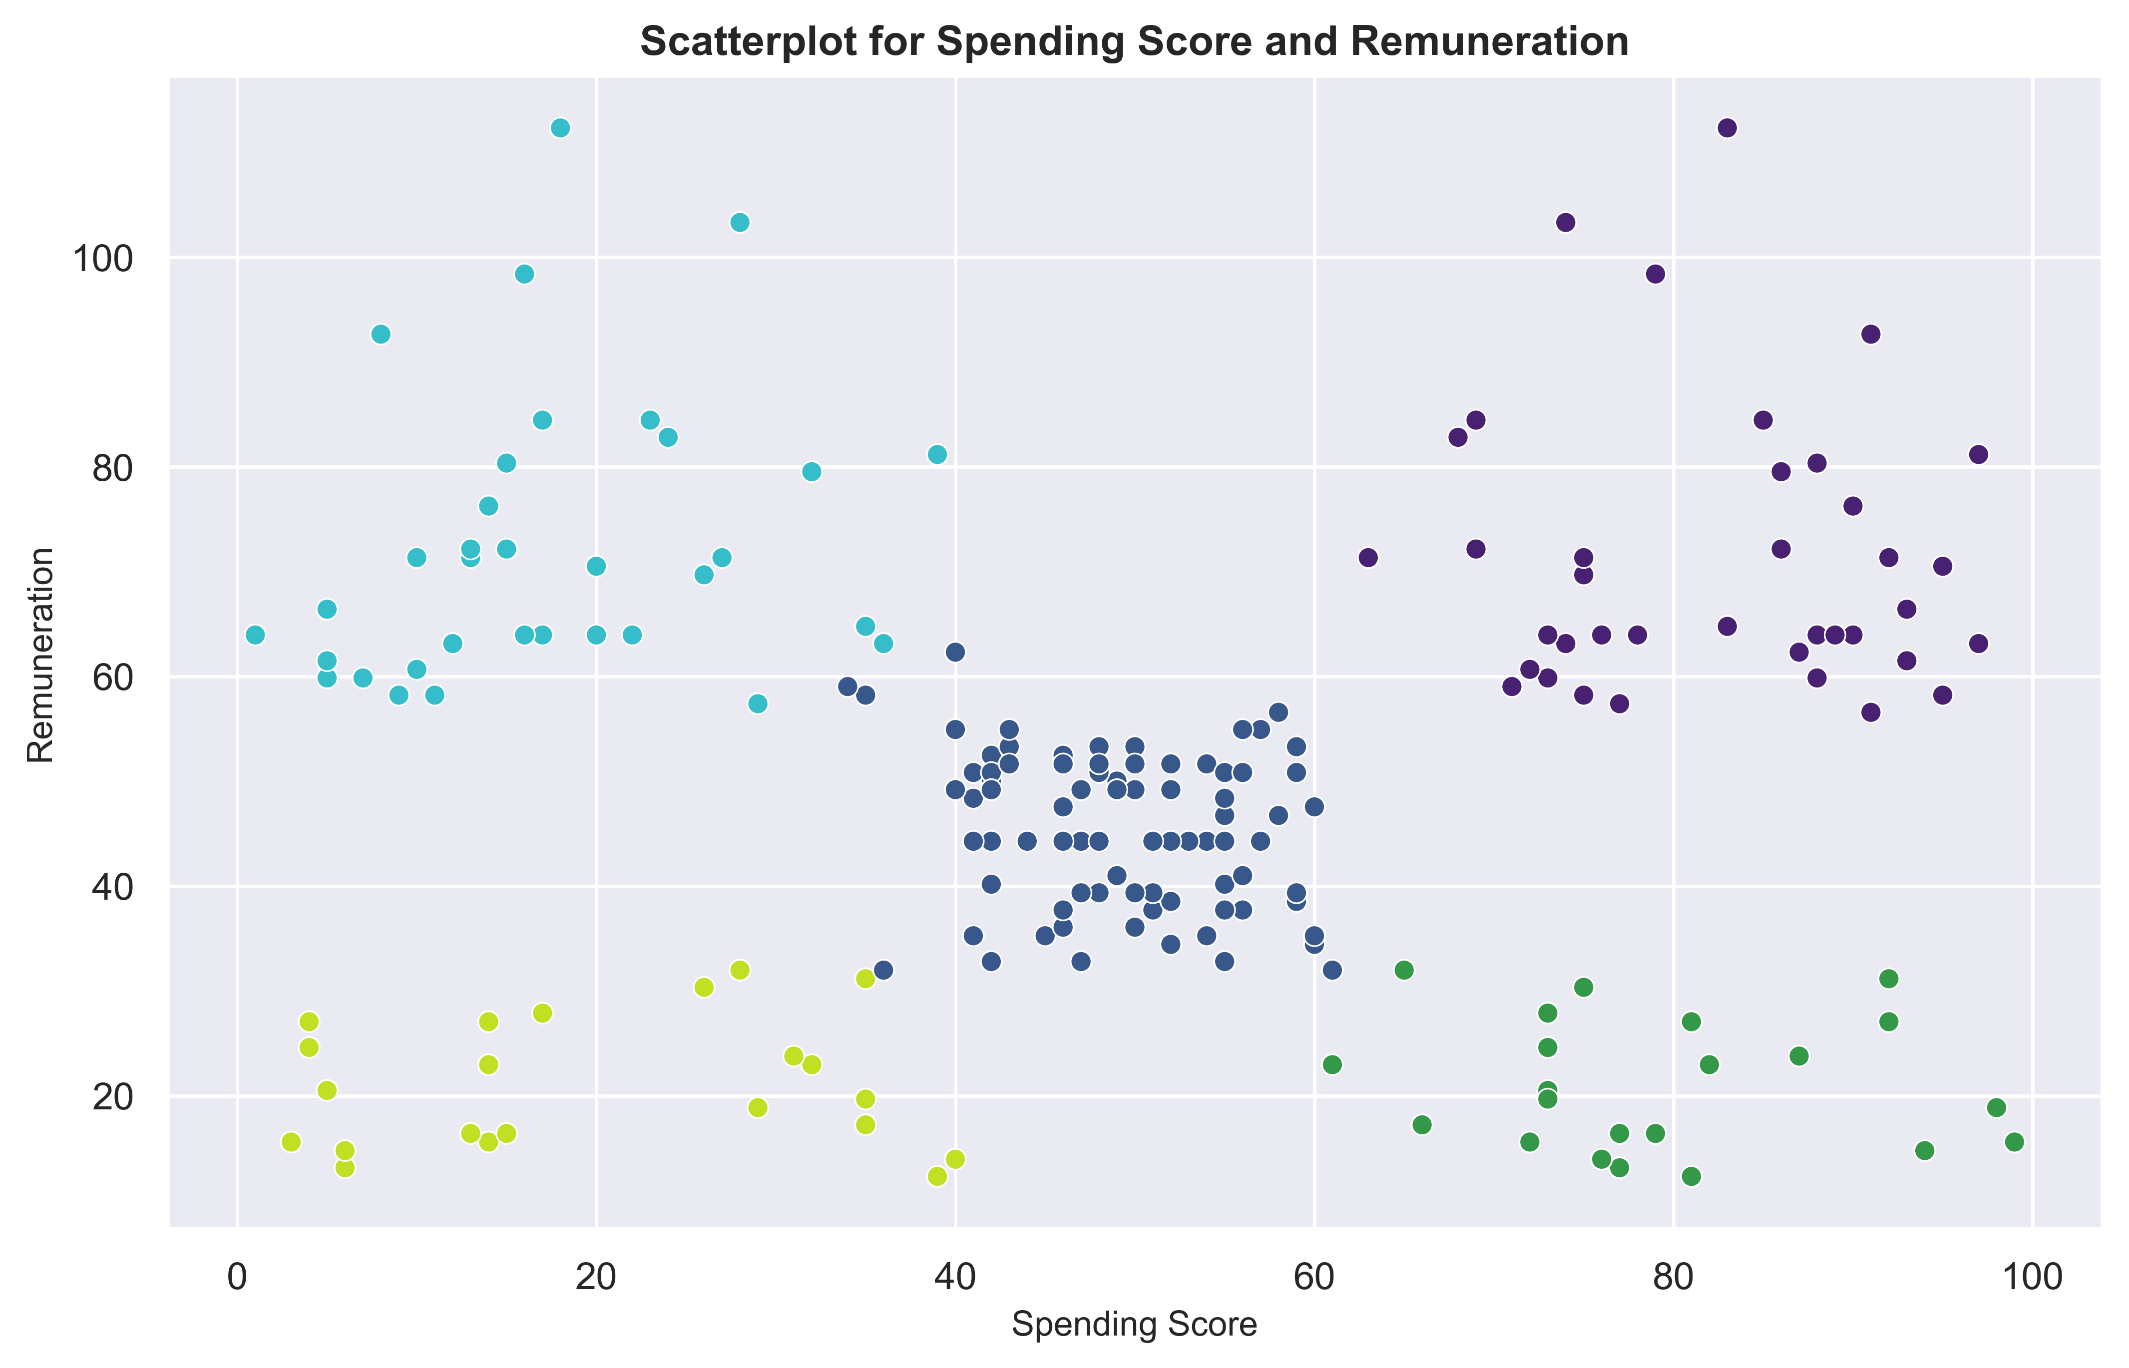
Customer Clusters
AFFLUENT SAVERS (17%)
Average Age: 40.7
Average Loyalty Points: 912
AFFLUENT SPENDERS (18%)
Average Age: 35.6
Average Loyalty Points: 3988
BALANCED SPENDERS (39%)
Average Age: 42.1
Average Loyalty Points: 1420
BUDGET SPENDERS (13%)
Average Age: 43.5
Average Loyalty Points: 275
VALUE SEEKERS (13%)
Average Age: 31.6
Average Loyalty Points: 972
Notes:
Taking a scatterplot to show the relationship between spending score and remuneration (main variables impacting loyalty points) we get 5 clusters,
The model can be expanded with the age variable, an the 5 clusters bascially remain.
Split 30% high spenders – for example affluent spenders have a high spending score and high income.
40% in the middle as balanced spenders
30% low spenders

Slide 13
Customer Cluster Characteristics
AFFLUENT SAVERS
Selective Consumers
Purchase of gifts
Infrequent visits
AFFLUENT SPENDERS
Younger
Entertainment
Early adopters
BALANCED SPENDERS
Conscious
Value for money
Compare prices
BUDGET SPENDERS
Selective Consumers
Look for offers
Infrequent visits
VALUE
SEEKERS
Younger
Entertainment
Spend now
Notes:
What other characteristics do the clusters share
High spenders are younger and are more likely be making purchases for own entertainment
Value Seekers with lower income are spending now not saving for the future
The affluent spenders focus on quality and exclusivity
The balanced spenders make up the largest group are are conscious of their purchases, potentially parents buying for their children,
The clusters with lower spending scores tend to be older, are likely to make less frequent visits and may be more likely to look for gifts rather than purchases for themselves.
The data showed that the top 10 products were different per cluster so to understand the impact on sales performance, more analysis needs to be done on product purchases.
Overall we can see that different customer clusters contribute differently to sales performance.

Slide 14
Reviews
Notes:
Next looking at reviews

Slide 15
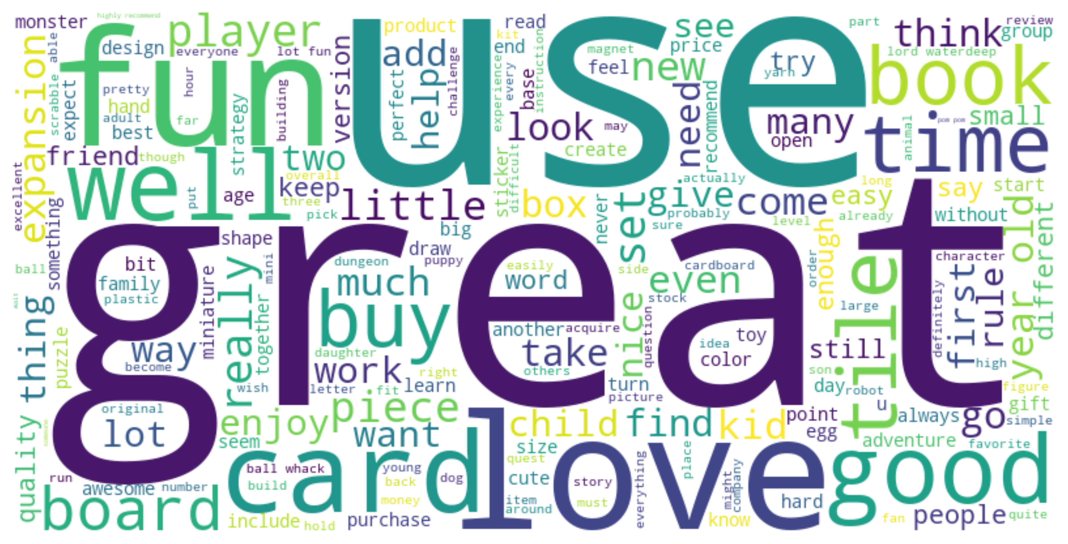
Natural Language Processing
Notes:
Split reviews into words
Take words down to their roots
Here you can see some of the most common words in a word cloud, such as great, love and fun

Slide 16
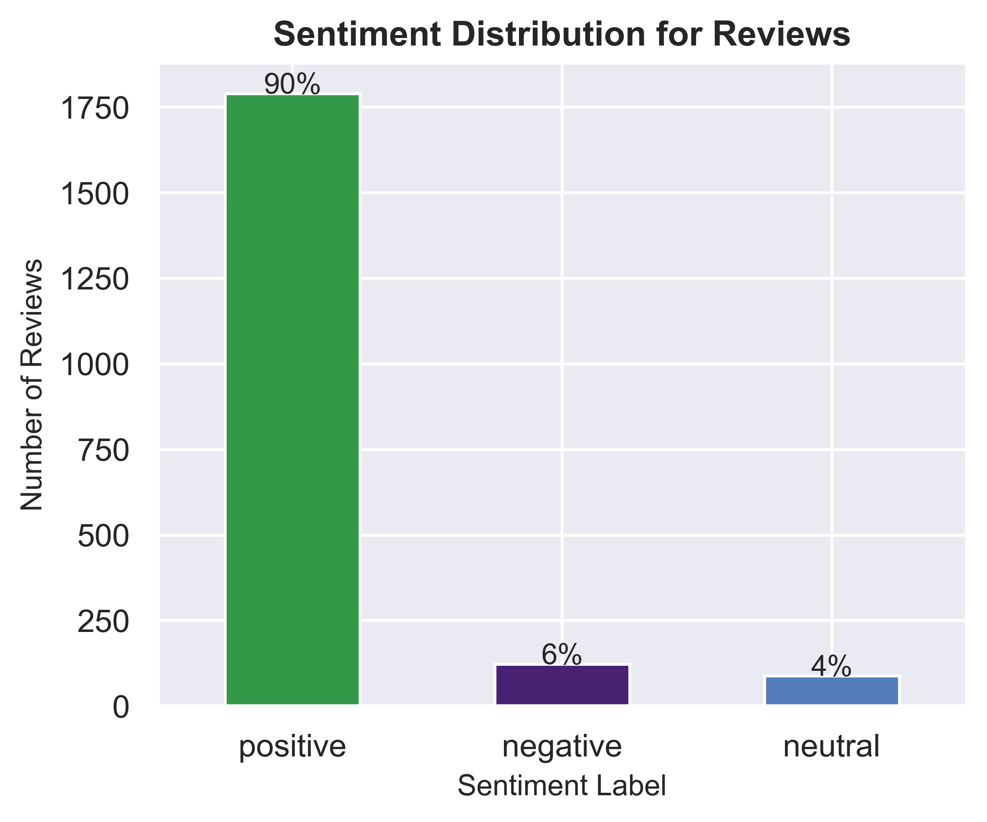
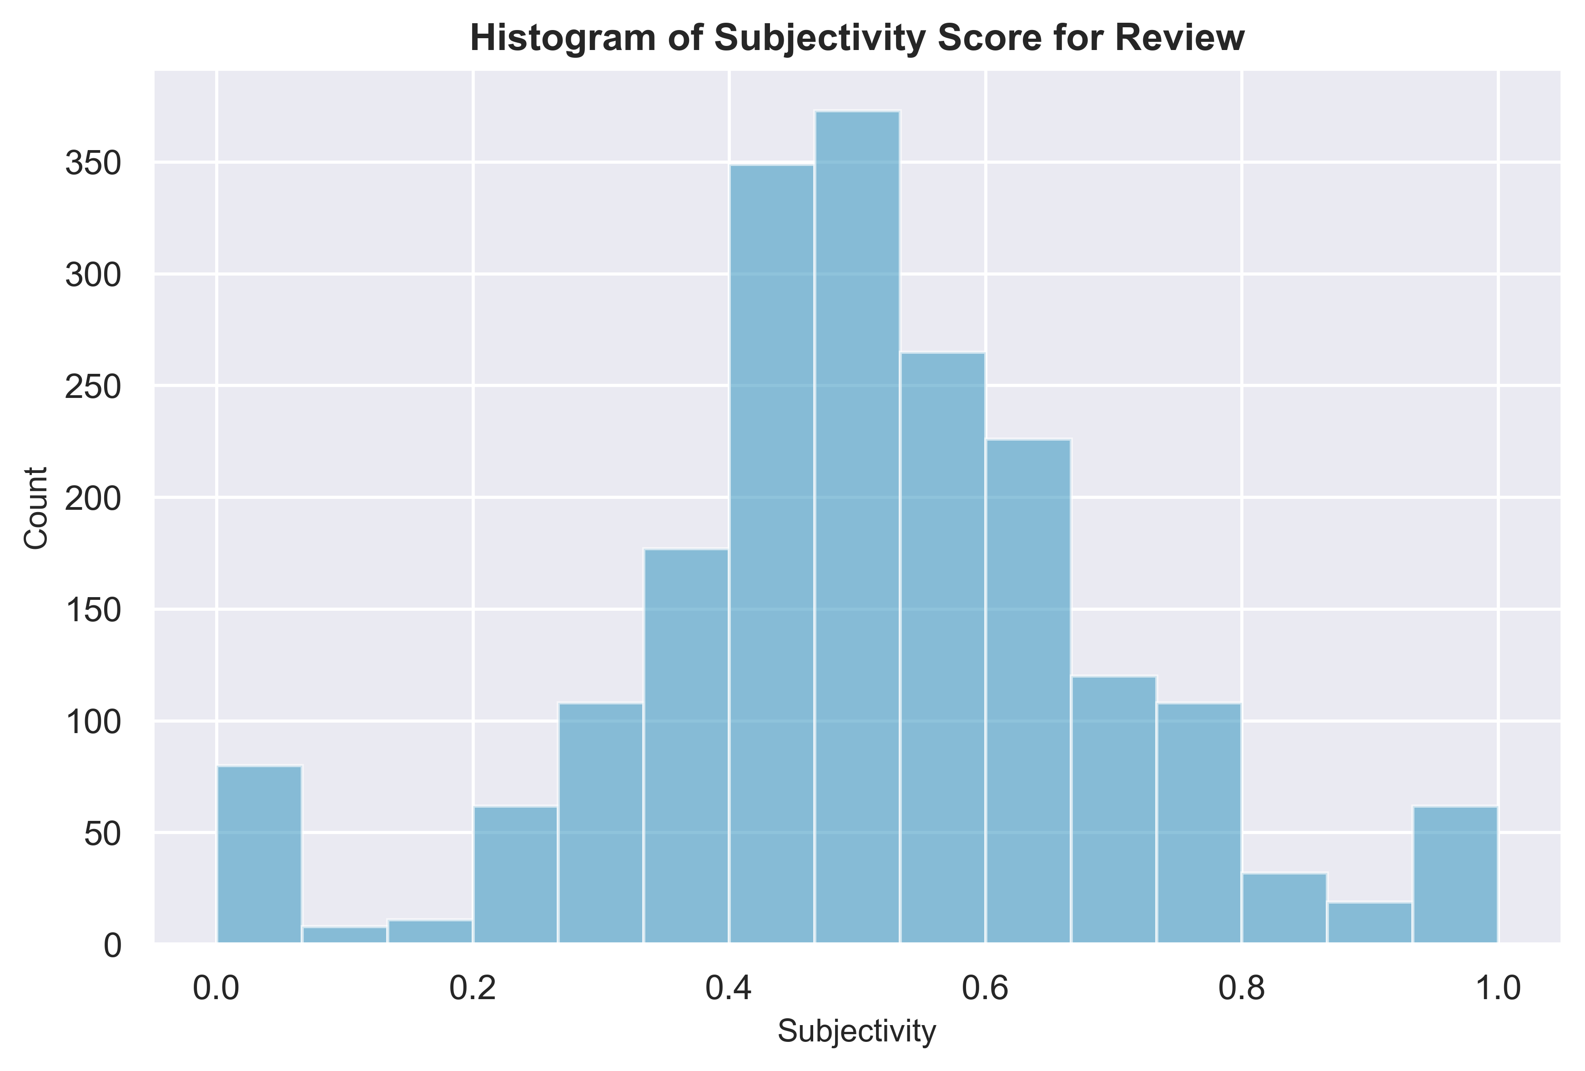
Review Sentiment & Subjectivity
objective
subjective
Notes:
Next I looked at Sentiment and Subjectivity of the reviews.
VADER sentiment Analysis was used and it categorises reviews as positive, negative, or neutral sentiments based on its emotional tone.
As you can see the feedback is mainly positive
Test accuracy: select 10 comments at random, assign sentiment and compare results.
Accuracy score (how many predictions model predicted accurately): 0.8
Textblob to analyse and understand text was used for the subjectivity analysis.
Subjectivity goes from 0 to 1 (with 0 being objective and 1 being subjective)
shows that of course reviews were not fully objective they were also quite balanced not too subjective with the majority clustered in the centre.

Slide 17
Recommendations
Notes:
So what are the reocmmendation from the analysis for the loyalty programme to improve sales performance?
Build on the positive perception seen in reviews, which is great foundation.
Expand data
Enhancing the programme
Focus on target audience

Slide 18
Better Data = Better Decisions

Slide 19
Expand the Dataset
Product Type,
Price & Margins
Spending Patterns
(Customer, Cluster, Product)
Family demographics
(marital status, no. of children, etc.)
Sales Channels
Geography
5 Turtle Review
Notes:
I already mentioned that different clusters had different top 10 products
High spend = many purchases or more expensive purchases
Terefore, look at product types, prices and margins in more detail
5 turtle review for numerical analysis of reviews to not solely rely on sentiment analysis

Slide 20
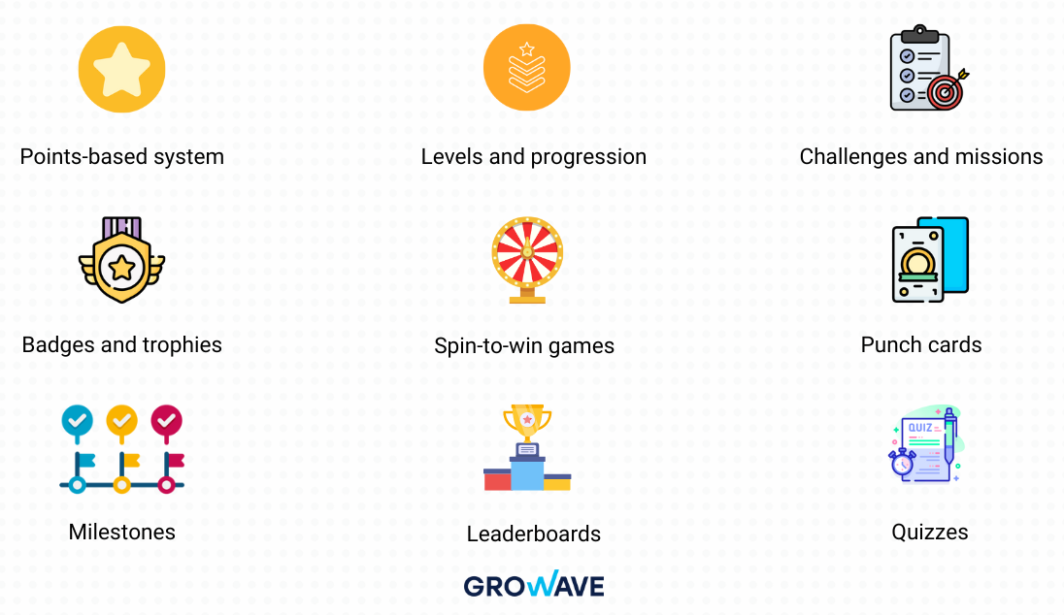
Gamification
Core Elements
Benefits
Higher Sales & Revenue
Enhanced Customer Retention
Valuable Customer Data
High Scalability and Adaptability
Notes:
Enhance your loyalty programme with Gamification
That means adding game-like elements, such as leaderboards, quizzes and challenges to increase engagement, enhance experiences and foster deeper brand connections.
You can see the core elements here shown from Grow Wave, a provider for complete retention ecosystem.
Example: Members complete tasks such as visiting a certain number of stores, purchasing new products which earns them bonus points or exclusive access to limited offers.
Benefits
Sales: there are companies that generate 80% of sales from loyalty programme
We already saw that retention is important in today’s market
Data: which means more insights into customer preferences and behaviour. The Global Customer Loyalty Report found 55.1% Would rather share information about myself through games or quizzes.
https://www.growave.io/blog/gamification-loyalty-programs#:~:text=Victoria's%20Secret%20PINK%20REWARDS%20is,through%20interactive%20and%20rewarding%20experiences.

Slide 21


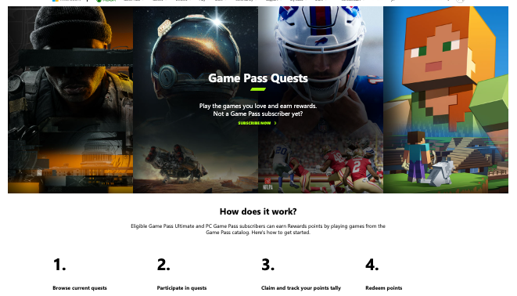
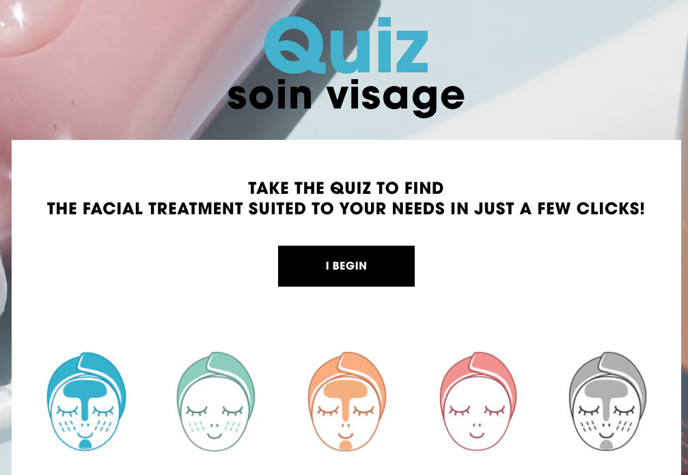
Gamification Examples
Notes:
X-Box: motivate players to gain rewards through different challenges within the game, to then make purchases in the Xbox Store.
Sephora introduced “Beauty Insider Challenges” for members to earn extra points with both online and offline activities.
Especially younger audience (18-34) are more drawn to this type of digital engagement
https://www.bcg.com/publications/2024/loyalty-programs-customer-expectations-growing

Slide 22
Target audience
VALUE SEEKERS (13%)
Younger
Focus on Now
AFFLUENT SPENDERS (18%)
Younger
Early Adopters
AFFLUENT SAVERS (17%)
Selective Consumers
Infrequent visits
Budget Friendly
🎯 Affordability & Discounts
🔒 Flexible Payment & Bundles
Premium Quality
🎯 Exclusivity & Unique Offers
🔒 Exclusive Access
Long term focus
🎯 Value & Quality
🔒 Points & Discounts
4 out of 10 consumers want more ways to earn points - not just with transactions (Antavo)
Notes:
This takes us to our target audience
We found that younger customers tend to have higher spend. They respond well to gamification, as many 25-34 years play board games regularly
So you want to reach your value seekers with affordability and discounts and locking them in with flexible payment options
Your are more likely to reach your affluent spenders with unique offers and exclusive access.
Not to forget your affluent savers that you can try to get to spend more through a long term focus on value & quality and loyalty engagement.
Because in the Global_Customer_Loyalty_Report_2025_by_Antavo they also found that
4 out of 10 consumers want more ways to earn points - not just with transactions
. (https://www.kylingm.com/board-games-statistics/)

Slide 23

Loyalty points with increasing income
Female Graduate
Age (years): 21
Remuneration: 18
Age (years): 31
Remuneration: 23.5*
+ 10 years
Loyalty Points: 712
Loyalty Points: 1,139
+ 60%
*assuming a 2% income increase per year
Notes:
Lets look at an example of a female graduate.
We cannot impact remuneration / income, but you can engage value seekers early & try and turn them into affluent spenders.
Look at her at the age of 21 with an income of 18k GBP and 712 loyalty points according to the model prediction.
10 years later with an assumed 2% increase in salary per year she earns 23.5kGBP and has 1139 loyatly points
That is a 60% icnrease, while income only increased by 30%

Slide 24
Next Steps
Expand the data set
Narrow your target audience
Implement gamification aspects
Define & measure KPIs
Notes:
So what should be the recommended next steps to leverage use the loyalty programme to enhance sales performance?
Expand the data set to really understand your customers
Based on that narrow your target audience
Implement gamification aspects – to catch younger shoppers early and focus on retention
KPIs: ROI, Adoption rate, Reward redemption rate, Repeat purchases, Incremental sales, Reduced customer churn, Customer lifetime valu

